Slide 1
ARP Poisoning And Mitigation Techniques
By
Shubham Sanjay Sonawane
CCE - B
159103067

Slide 2

Problem Statement
Performing Man In The Middle attack using ARP Poisoning and finding a reliable counter measure.

Slide 3



What is ARP Poisoning?
Address Resolution Protocol (ARP) poisoning is a form of attack in which an attacker changes the MAC address and attacks LAN by changing the target computer's ARP cache.
This modifies victims MAC address into the hacker's own MAC address allowing hacker's computer first instead of sending it to the original destination.
Alice
Bob
Eve

Slide 4
Working Of ARP
When one machine needs to communicate with another, it looks up its ARP table.
If the MAC address is not found in the table, the ARP-request is broadcasted over the network.
All machines on the network will compare this IP address to MAC address.
If one of the machines in the network identifies this address, then it will respond to the ARP-request with its IP and MAC address.
The requesting computer will store the address pair in its ARP table and communication will take place.

Slide 5

IP Address | MAC Address
10.168.0.1 | 64-d1-54-38-35-63
10.168.0.73 | 3c-a3-08-04-70-5b
10.168.0.91 | 64-d1-54-38-35-63
10.168.0.111 | ac-e0-10-f9-d2-c1
10.168.0.128 | 64-d1-54-38-35-63
10.168.0.166 | 50-c8-e5-ab-a9-6b
10.168.0.181 | 64-d1-54-38-35-63
10.168.0.197 | ac-e0-10-fa-e2-ab
10.168.0.204 | 00-cd-fe-b2-76-7f
10.168.0.251 | 67-h6-98-3f-24-dd
10.168.1.19 | 64-d1-54-38-35-63
10.168.1.32 | 20-16-b9-64-d3-cc
10.168.1.33 | ac-e0-10-ff-8b-9f
10.168.1.50 | ac-e0-10-ff-99-36
10.168.2.14 | f8-59-71-00-07-c1
10.168.2.173 | e4-a7-a0-5b-77-41
10.168.2.181 | ac-e0-10-ff-9a-a4
10.168.3.25 | ac-e0-10-ff-8d-21
10.168.3.39 | 64-d1-54-38-35-63
10.168.3.105 | e0-98-61-8a-48-10
10.168.3.195 | ac-e0-10-ce-b2-a9
10.168.3.198 | e4-b3-18-cd-69-2d
10.168.3.238 | f0-03-8c-07-e0-1d
Look For
MAC
Sender
ARP Request (Broadcast)
Not Found

Slide 6


IP Address | MAC Address
10.168.0.1 | 64-d1-54-38-35-63
10.168.0.73 | 3c-a3-08-04-70-5b
10.168.0.91 | 64-d1-54-38-35-63
10.168.0.111 | ac-e0-10-f9-d2-c1
10.168.0.128 | 64-d1-54-38-35-63
10.168.0.166 | 50-c8-e5-ab-a9-6b
10.168.0.181 | 64-d1-54-38-35-63
10.168.0.197 | ac-e0-10-fa-e2-ab
10.168.0.204 | 00-cd-fe-b2-76-7f
10.168.0.251 | 4a-h3-19-e3-2f-6c
10.168.1.19 | 64-d1-54-38-35-63
10.168.1.32 | 20-16-b9-64-d3-cc
10.168.1.33 | ac-e0-10-ff-8b-9f
10.168.1.50 | ac-e0-10-ff-99-36
10.168.2.14 | f8-59-71-00-07-c1
10.168.2.173 | e4-a7-a0-5b-77-41
10.168.2.181 | ac-e0-10-ff-9a-a4
10.168.3.25 | ac-e0-10-ff-8d-21
10.168.3.39 | 64-d1-54-38-35-63
10.168.3.105 | e0-98-61-8a-48-10
10.168.3.195 | ac-e0-10-ce-b2-a9
10.168.3.198 | e4-b3-18-cd-69-2d
10.168.3.238 | f0-03-8c-07-e0-1d
Look For
MAC
Sender
Packet
Accepted
Broadcast
Msg
False
(Replay
with error query)
MITM
True
(Packed
Accepted)
Check
MAC
Receiver

Slide 7


Perform Spoofing Using Scapy

Slide 8
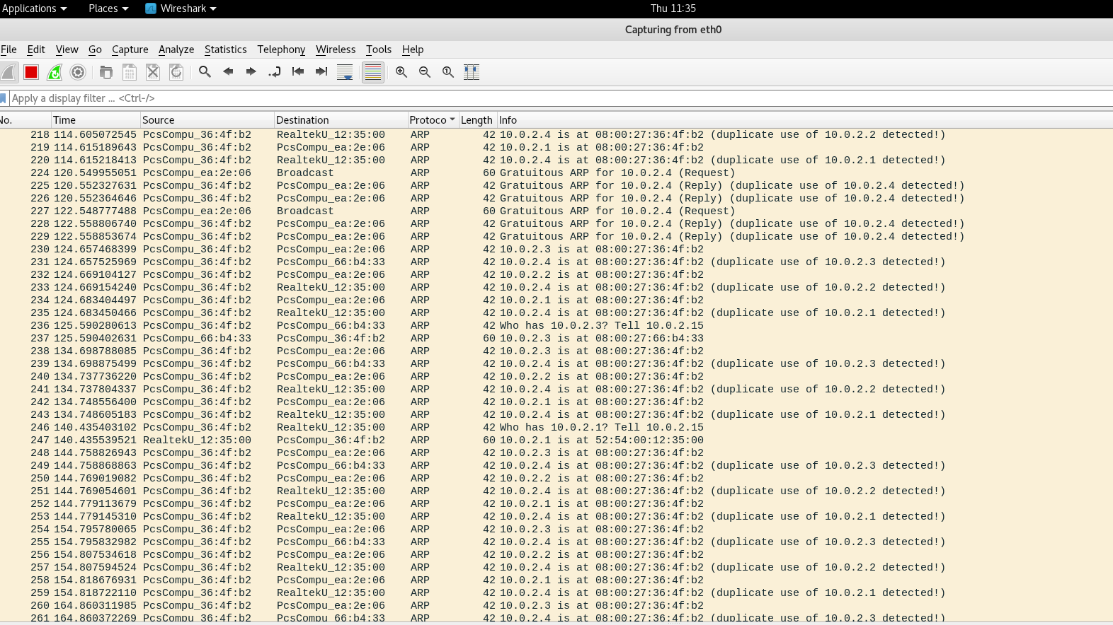

Slide 9
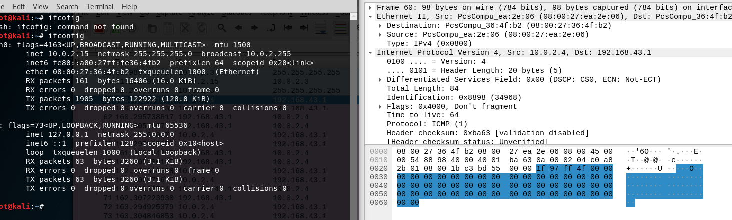

Slide 10
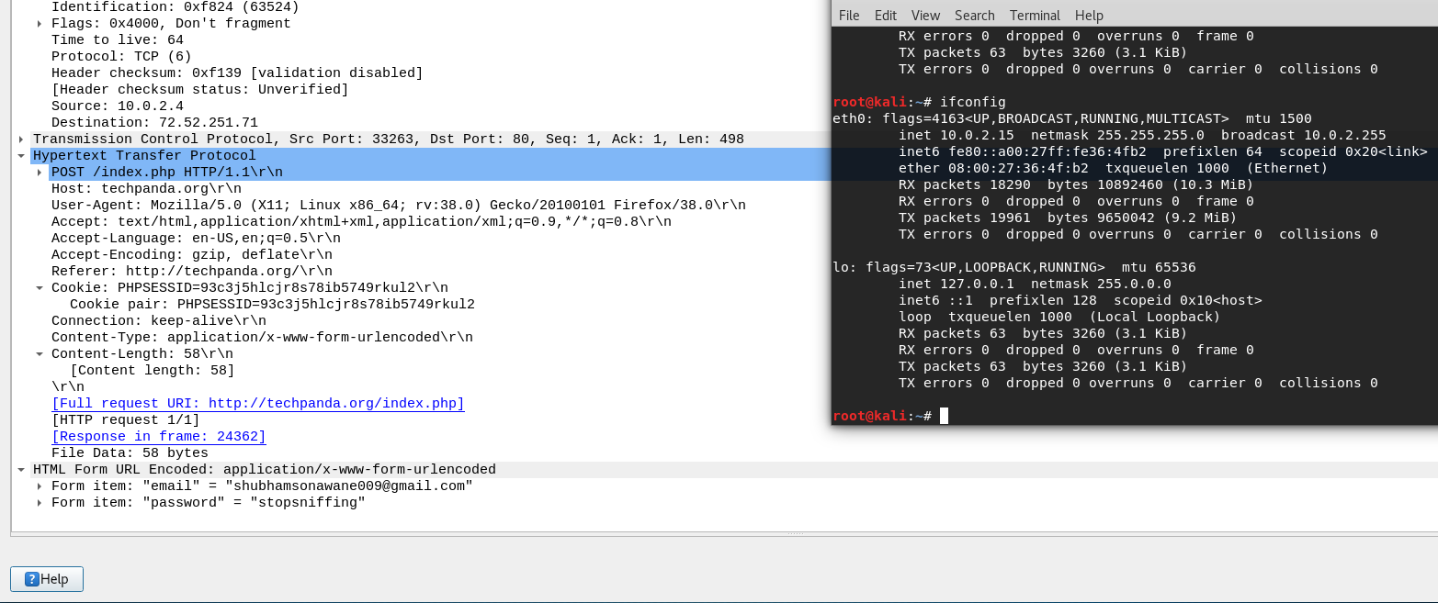

Slide 11
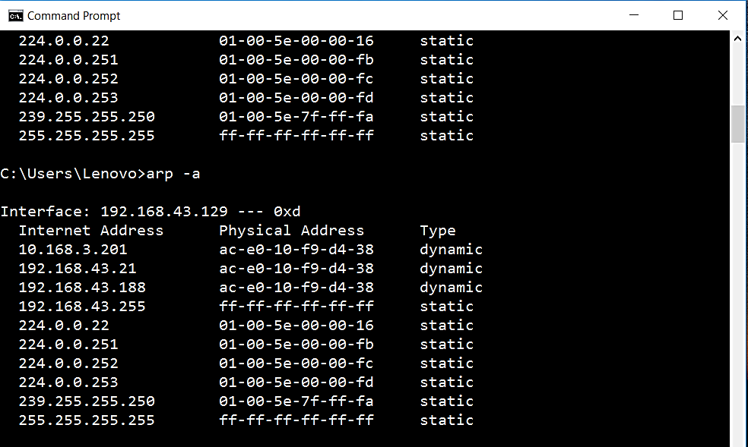

Slide 12

Prevention
Use Virtual Private Networks
Use Anti-ARP Tools (ex: X-Arp, Arp Freeze, Anti Spoofer)
Use ARP-Spoofing Proof Switches
Packet Filter
Using Static ARP

Slide 13
Work To Be Done
Packet spoofing by MITM
Compromising message integrity
Implementation of mentioned mitigation techniques

Slide 14
References
Jeff King, Kevin Lauerman, ARP Poisoning Attack and Mitigation Techniques, A CSSTG SE Residency Program White Paper, Jan 22, 2016
Goyal V., Tripathy R., An Efficient Solution to the ARP Cache Poisoning Problem. In: Boyd C., González Nieto J.M. (eds) Information Security and Privacy. ACISP 2005.
Address Resolution Protocol Poisoning (ARP Poisoning), https://www.techopedia.com/definition/27471/address-resolution-protocol-poisoning-arp-poisoning, viewed on Sep, 2018
ARP spoofing with scapy (NETLAB), https://samsclass.info/124/proj11/P13xN-arpspoof.html, viewed on Sep, 2018.
Learn How to Prevent ARP Spoofing the Best Way, https://www.purevpn.com/blog/prevent-arp-spoofing/, viewed on Sep 2018.

Slide 15
Thank You

